Slide 1

Final year project
Proposal defense

Slide 2
words in action Converting text/Script into animation
Group:
Shan Akbar (I16-0149)
Hamza Tariq (I16-0134)
Irfan ULLAH (I16-0533)
Supervisor:
Dr. Mirza Omer Beg

Slide 3
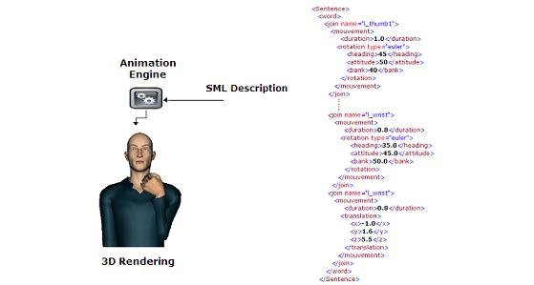
Project OVERVIEW
Complexities of semantics
Visualization of natural language

Slide 4
Motivation
If a picture tells a thousand words, then animation tells a million
Same view for many people
A data set for neural networks

Slide 5

Goals
Extracting Semantics from Text
Generating 3D Animation from Semantics

Slide 6


Scope
Only English
Human related script only
Fixed set of actions
Human Actions
Limited set of actions and objects

Slide 7
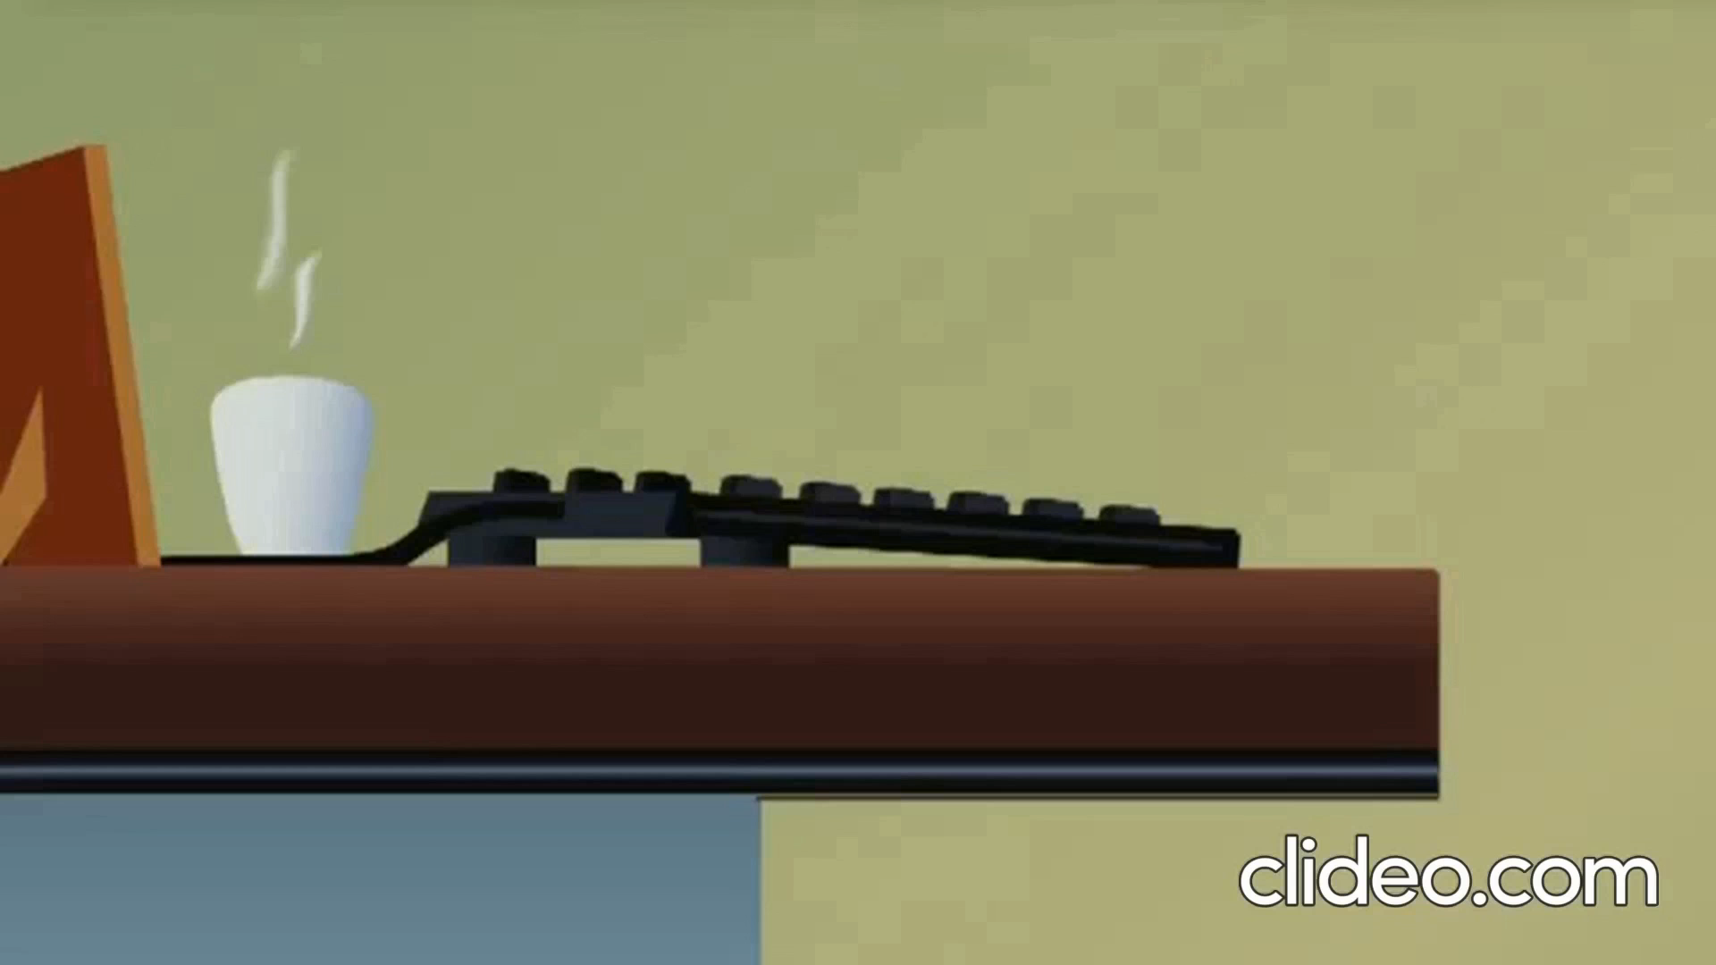
Expected outcomes

Slide 8
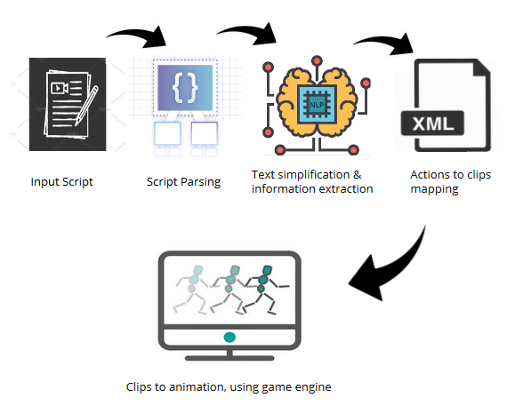
Modules

Slide 9




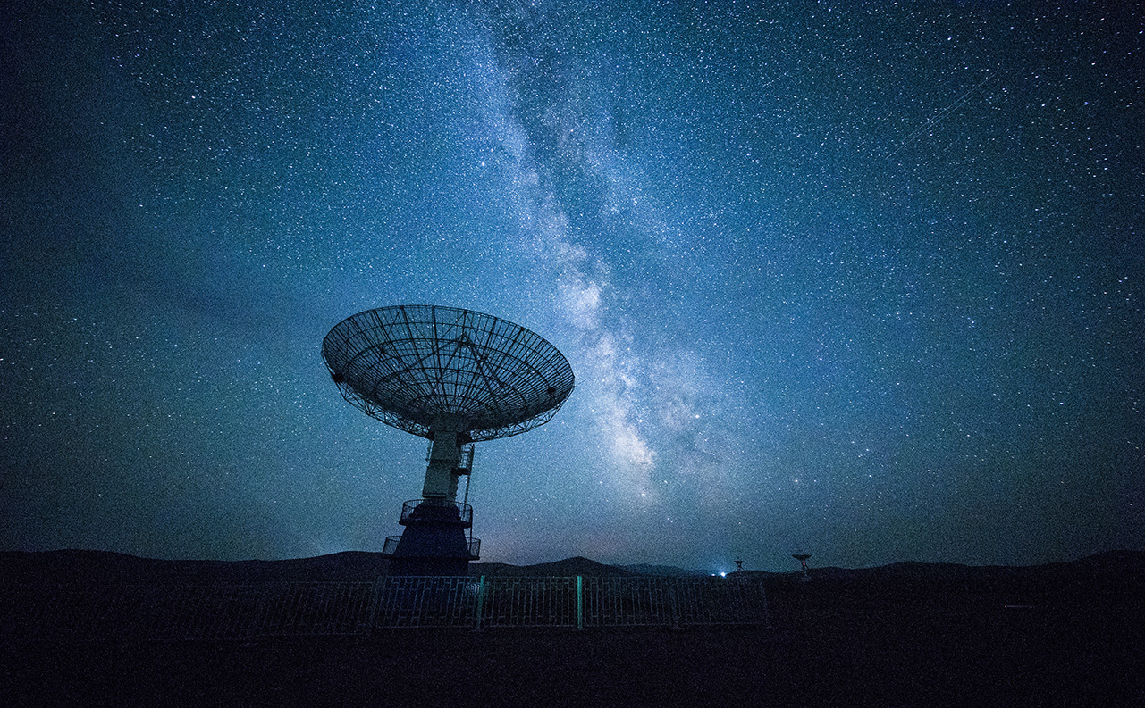
Technologies

Slide 10
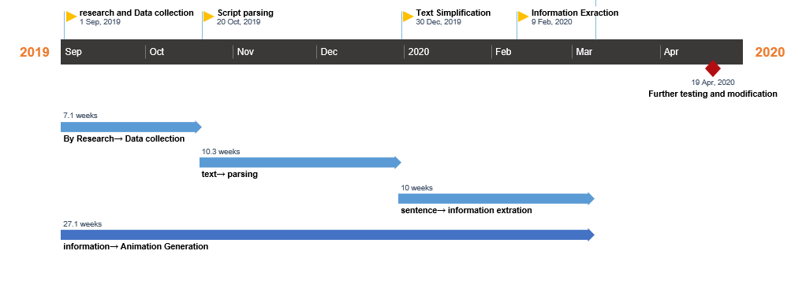
timeline

Slide 11

Thank You!

Slide 12
references
Zhi-Qiang Liu and Ka-Ming Leung. 2006. Script visualization (scriptviz): a smart system that makes writing fun. Soft Computing, 10(1):34–40.
M. Oshita 2009. Generating animation from natural language texts and framework of motion database. In International Conference on CyberWorlds, 2009. CW’09, 146–53. DOI:10.1109/CW.2009.46. Masaki
Oshita. 2010. Generating animation from natural language texts and semantic analysis for motion search and scheduling. Vis. Comput. 26, 5, 339–52. DOI:10.1007/s00371-010-0423-4.
Hyunju Shim, Bogyeong Kang, and Kyungsoo Kwag. 2009. Web2Animation - automatic generation of 3D animation from the web text. In IEEE/WIC/ACM International Joint Conferences on Web Intelligence and Intelligent Agent Technologies, 2009. WI-IAT’09, 1:596–601. DOI:10.1109/WI-IAT.2009.101.

